Slide 1

Swing State Super PAC Donations: Ohio - 2016 Presidential Election
By Rachel Ward
DAV 5400 – Final Project

Slide 2
Purpose
Super Political Action Committees (‘PACs’) had their rights strengthened by recent court decisions
They are entities which can spend unlimited amounts of money to influence elections provided they are not in direct contact with an official campaign
i.e. radio/tv/social media advertisements, free swag that they give out, etc.
In the 2016 election Super PAC spending was astronomically high
For this project I analyzed what, if any, impact donations to Super PACs by individuals in the state of Ohio had on the presidential election results in that state.

Slide 3
Main Hypothesis
Most counties in Ohio were won by the party who had the highest amount of donations to Super PACs that are affiliated with that party.

Slide 4
Data Sources
Federal Election Commission Data on Individual Super PAC donations (csv)
01
Matched this with county data using the uszipcode library
Ohio Secretary of State - Presidential Election Results by County (csv)
02
OpenSecrets.org - Super PAC viewpoints (liberal/conservative) (web scraping)
03
04
05
USDA – FIPS codes for geo-mapping (web scraping)
GitHub–JSON file with FIPS codes and geolocations for geo-mapping (JSON)

Slide 5
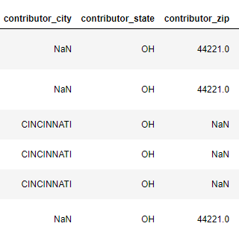

Challenges - Data
Unclean data – missing zip codes, missing city names, different zip code formats
Used google search to find out the appropriate city based on address and zip code, or zip code based on address and city
Used the loc Function to fill in these missing values

Slide 6
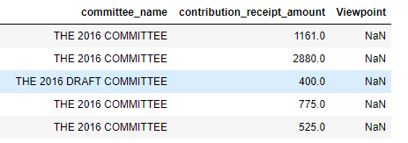
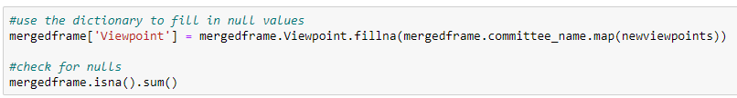
Challenges - Data
Half of the Super PAC’s that people donated to were not listed on the opensecrets.org website
I researched these and created a dictionary to map the new values to the data frame

Slide 7
Challenges – Technical/Legal
Copyrights
Found a different source of information
Planned to use Selenium and Beautiful Soup to web scrape, but my browser’s firewall blocked my access to web scrape
Changed my firewall access, but then my browser was not as up to date as the driver for web scraping
Updated my browser, still did not work
Found a different way using the requests library
Planned to use geopy nominatim to get the county information but it kept timing out
Found another way to get it using a google api, but that was not free
Eventually found another method, using pypl’s uszipcode library

Slide 8
Sample Data
 | County_Name | conservative_donations | liberal_donations | Total_Voters | Clinton_Votes | Trump_Votes | Other_Candidates | FIPS | State | party_donation_win | party_votes_win | combined_win
0 | Adams County | 1161.00 | 0.00 | 11583.00 | 2326.00 | 8659.00 | 598.00 | 39001 | OH | -1.00 | -1.00 | 1.00
1 | Allen County | 253280.00 | 220.00 | 46735.00 | 13294.00 | 30487.00 | 2954.00 | 39003 | OH | -1.00 | -1.00 | 1.00
2 | Ashland County | 825.00 | 0.00 | 25104.00 | 5740.00 | 17493.00 | 1871.00 | 39005 | OH | -1.00 | -1.00 | 1.00
3 | Ashtabula County | 575.00 | 50.00 | 41797.00 | 15577.00 | 23318.00 | 2902.00 | 39007 | OH | -1.00 | -1.00 | 1.00
4 | Athens County | 275.00 | 307.34 | 30042.00 | 16370.00 | 11354.00 | 2318.00 | 39009 | OH | 1.00 | 1.00 | 1.00

Slide 9
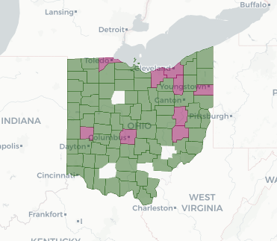
Results
Green indicates the party with the highest amount of Super PAC donations also had the most votes
74 out of 88 counties
Purple indicates the party with the highest amount of Super PAC donations did not have the most votes
9 out of 88 counties
White indicates that county did not have any donations to Super PACs
5 out of 88 counties

